Slide 1


IMDb Analysis: Unveiling Popularity Trends in TV Shows
Group 2: SeriesSense
Data Science and Machiene Learning - Tuwaiq Academy

Slide 2







Introduction
In our project we explore the world of popular TV shows using IMDb data and unsupervised machine learning. We delve into the data to uncover patterns and insights that shed light on viewer preferences and content trends.
Objective
Analyze popular TV shows from IMDb to identify patterns and group them using unsupervised machine learning.
Data Source
IMDb's "Most Popular" lists for movies and shows, providing reliable ratings and viewer preferences.

Slide 3
Data Acquisition
Scraped from IMDb's combined lists for TV shows and movies.
Dataset Exploration
Data Refinement
Initial broad dataset refined to shows for model building.
Why IMDb?
A reliable and continuously updated source, providing an accurate representation of viewer preferences.

Slide 4
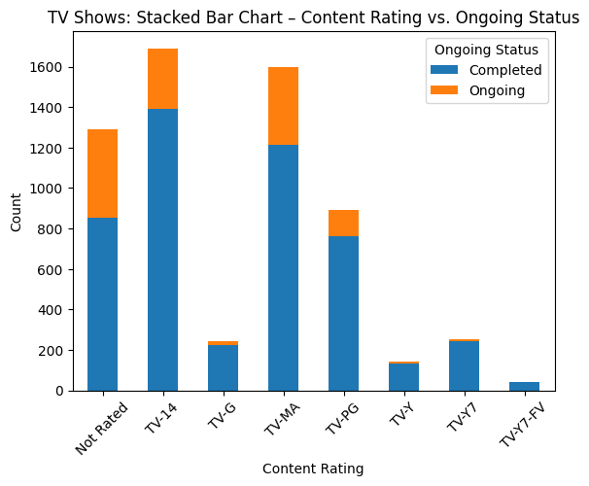
1
EDA
TV-14 is the most common rating, targeting teens and young adults.
Most shows are completed, with only a fraction still ongoing.
TV-MA shows are popular but have shorter lifespans.
Kids’ shows (TV-Y, TV-Y7) have higher longevity, likely due to reruns and steady demand.

Slide 5
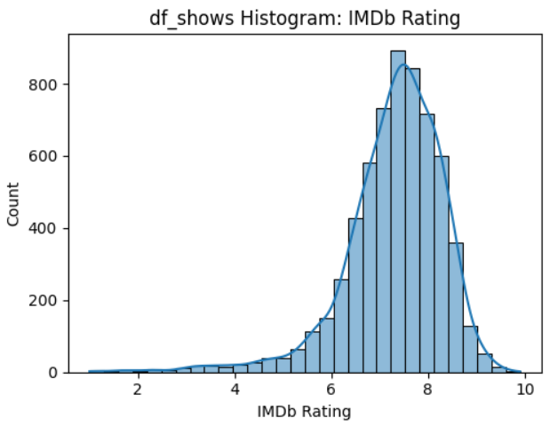
EDA
2
The ratings cluster around 6–8, revealing that most shows are moderately to well-received. Very few titles achieve extremely high or extremely low ratings, implying a fairly normal distribution around the midrange.

Slide 6
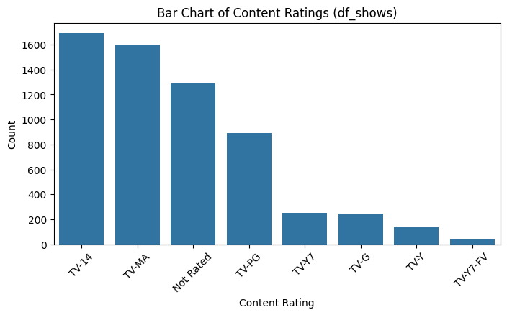
EDA
3
Most shows fall under TV-14 and TV-MA, suggesting a strong focus on teen and mature audiences. A notable number of titles are also Not Rated, might indicate older shows.

Slide 7
Feature Engineering
Rank and Series Name:
Separated the combined column into distinct Rank and Name features.
Year Information:
Divided year string into start_year and end_year, and derived run_length.
Ongoing Shows :
Created a binary ongoing feature (1 for shows still airing, 0 for concluded).

Slide 8
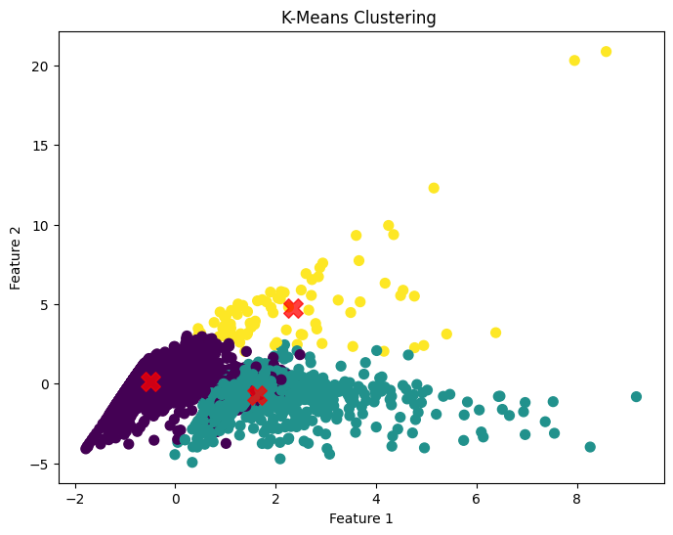
Model Selection
Algorithms Explored :
KMeans and DBSCAN were analyzed for their ability to cluster TV shows based on selected features.
Chosen Features:
IMDb Rating
Total Ratings
run_length
ongoing

Slide 9
Model Selection
KMeans Clustering: Identifying TV Show
Cluster 0: Concluded shows ✔️-> typically with a moderate number of ratings and a short run length.
Cluster 1: Shows still running⏳-> generally with a similar number of ratings to Cluster 0 but a significantly longer run length.
Cluster 2: Blockbuster shows 🌟-> distinguished by a very high number of ratings, a longer run length, and a significant percentage still airing.

Slide 10
Conclusion
Recap:
The analysis leveraged IMDb’s trusted data to explore TV show popularity using unsupervised machine learning.
Key Insights:
Cluster 0 (Concluded): Short-run, concluded shows with moderate ratings.
Cluster 1 (Running): Long-running, active shows.
Cluster 2 (Blockbuster): High-rated, popular shows with a strong fan base.

Slide 11
Q&A Session
Let’s Discuss
Group 2: SeriesSense

Slide 12
Thank You
Group 2: SeriesSense
Ahmed Alhassar
Manar Alshykh
Sarah Belal
Ahmed Alharbi
FINISH

